Slide 1
Intro Note
Please read before presenting
to your team.
!
This document is meant for you to configure to reflect your process as there are variations in how XL can be configured.
Each variation is called out with the symbol on the right.
When you see this symbol, keep the slide for the variation you use and delete the other slide
Title Part 1 Section 1
www.vorne.com • 1.630.875.3600 • © 2025 Vorne
Notes:
Delete slide notes:
Finesse the “delete slide” approach
Instead of a big “in your face” explanatory slide for every single section, maybe just a small symbol on each slide – basically indicating “there should only be one of these,” choose the one that applies to your config

Slide 2
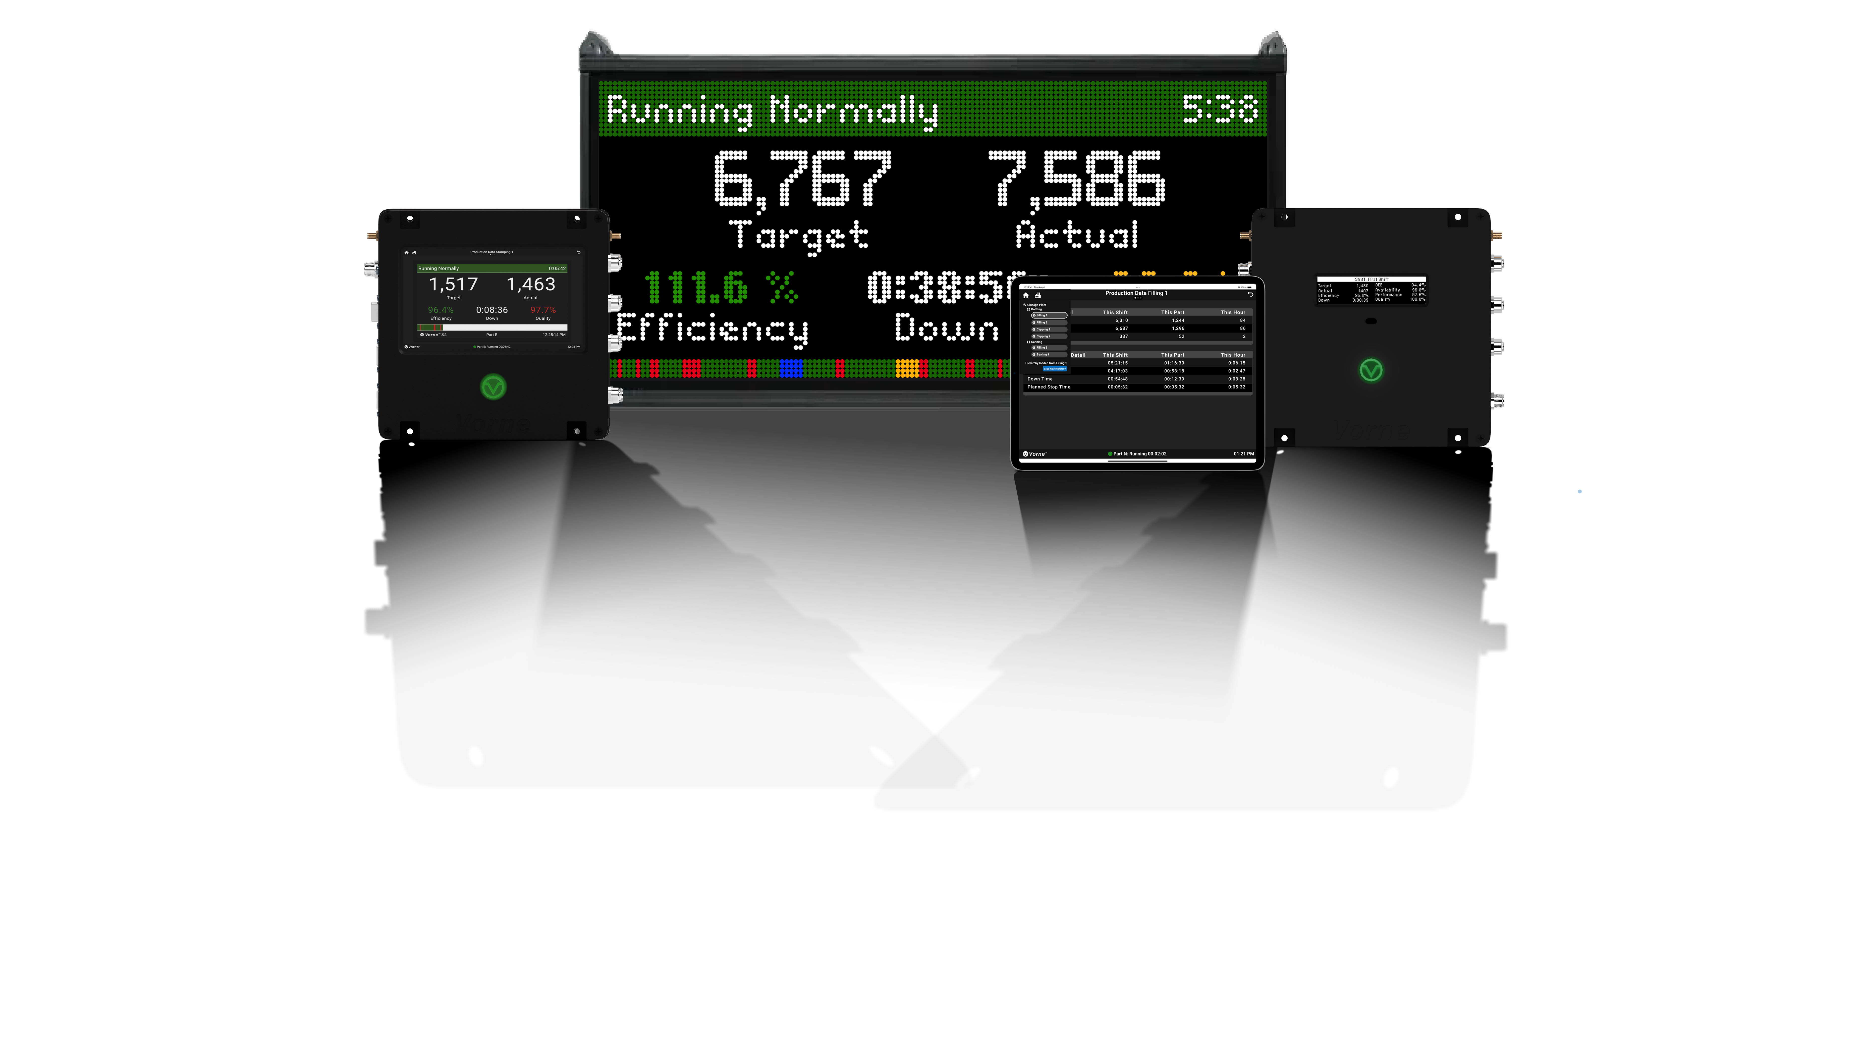

Operator’s Guide to XL
Your XL Champion name goes here
Your company name goes here
www.vorne.com • 1.630.875.3600 • © 2026 Vorne Industries, Inc. • Itasca, IL
Notes:
Intro section notes:
Focus on “culture of productivity” aim
“here’s how XL can help you” – convey, not convince

Slide 3
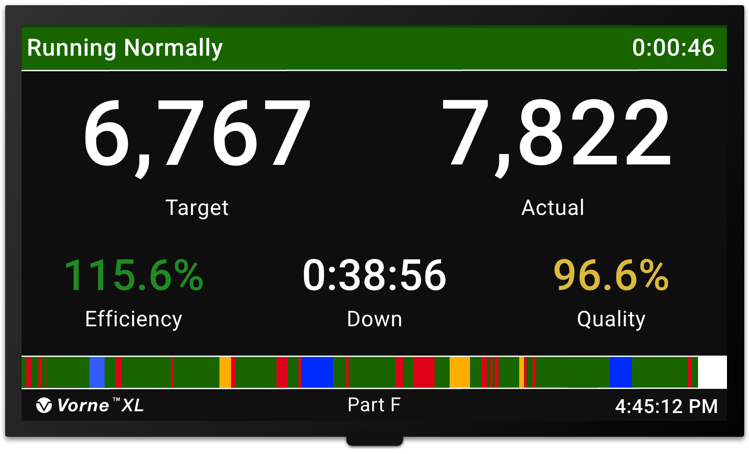
What Is XL?
An operator’s perspective
XL is a device that captures metrics from the line and displays information for you in real-time
Some information is automatically captured by XL, but some must be input by you
You interact with the XL using barcode scanners or touch interfaces
Our goal is to “win the shift” by meeting or beating the Target metric
www.vorne.com • 1.630.875.3600 • © 2026 Vorne

Slide 4

Who Uses XL?
XL is used by operators, supervisors, and managers.
We all need accurate information to help us make good decisions
On the plant floor, XL gives us clear visibility of goals and how we are doing
Supervisors can see areas that need extra attention in real-time
Managers can see trends over time and plan for the future
Title Part 1 Section 1
www.vorne.com • 1.630.875.3600 • © 2026 Vorne
www.vorne.com • 1.630.875.3600 • © 2026 Vorne

Slide 5
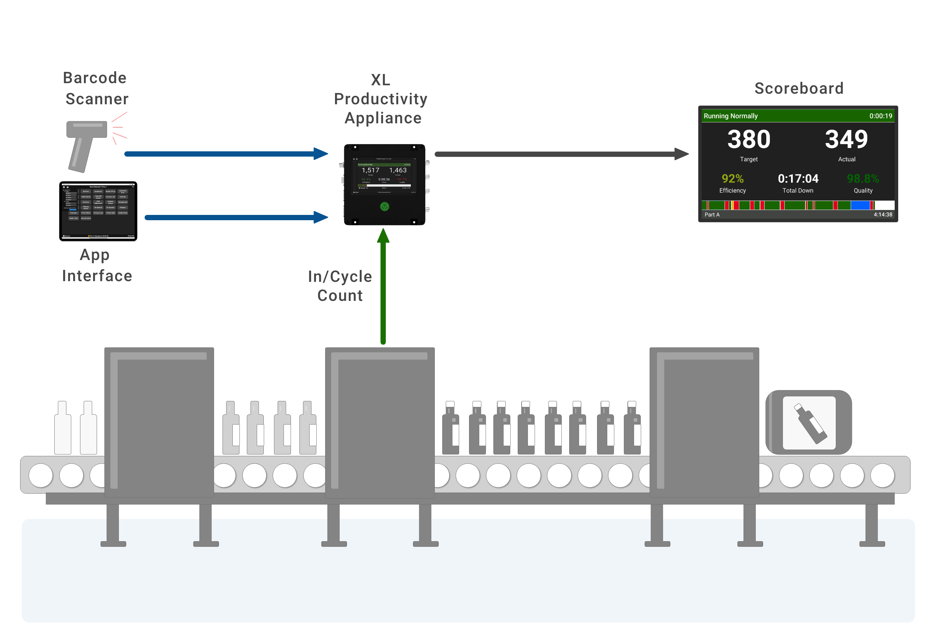
How XL Fits in
XL is easy to use.
Sensors automatically monitor production
Barcode scanner and touch interface are the primary ways you provide information to XL
Scoreboard shows us what is happening on the plant floor
!
Select One
Title Part 1 Section 1
www.vorne.com • 1.630.875.3600 • © 2026 Vorne
www.vorne.com • 1.630.875.3600 • © 2026 Vorne
Notes:
Notes:
Don’t focus so much on “how installed” as “where XL fits into your production/line setup”

Slide 6
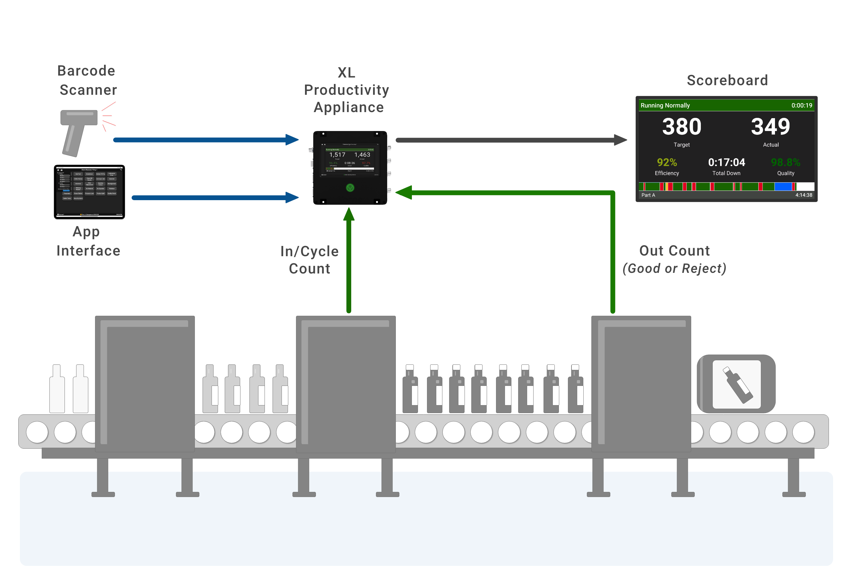
How XL Fits in
XL is easy to use.
Sensors automatically monitor production
Barcode scanner and touch interface are the primary ways you provide information to XL
Scoreboard shows us what is happening on the plant floor
!
Select One
Title Part 1 Section 1
www.vorne.com • 1.630.875.3600 • © 2026 Vorne
www.vorne.com • 1.630.875.3600 • © 2026 Vorne
Notes:
Notes:
Don’t focus so much on “how installed” as “where XL fits into your production/line setup”

Slide 7
Performing Actions
Actions typically capture three things.
Down Reasons
Help us to identify improvements
Part Changes
Apply correct settings for each part, product, or SKU
Start Events
Begin planned stops that are not reflected in the time schedule
Title Part 1 Section 1
www.vorne.com • 1.630.875.3600 • © 2026 Vorne
www.vorne.com • 1.630.875.3600 • © 2026 Vorne
Notes:
Related notes:
After the Scanning slide – add a slide on “the touch UI” – emphasize that it’s in both Touch and Sidekick

Slide 8
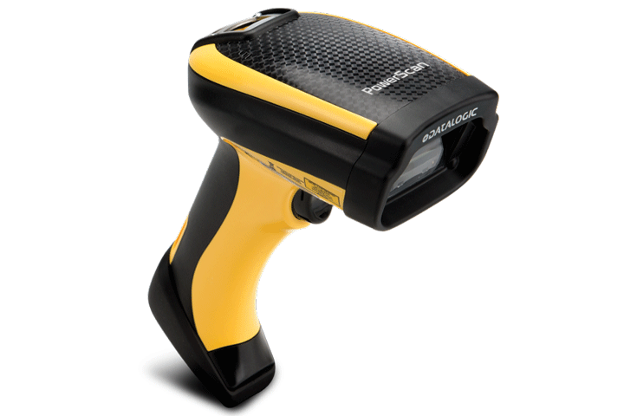

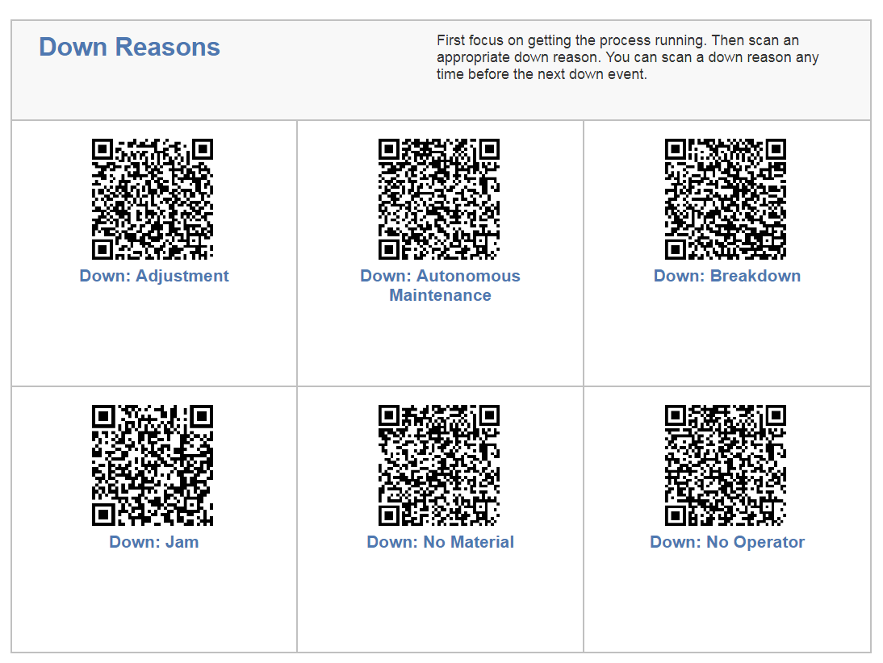
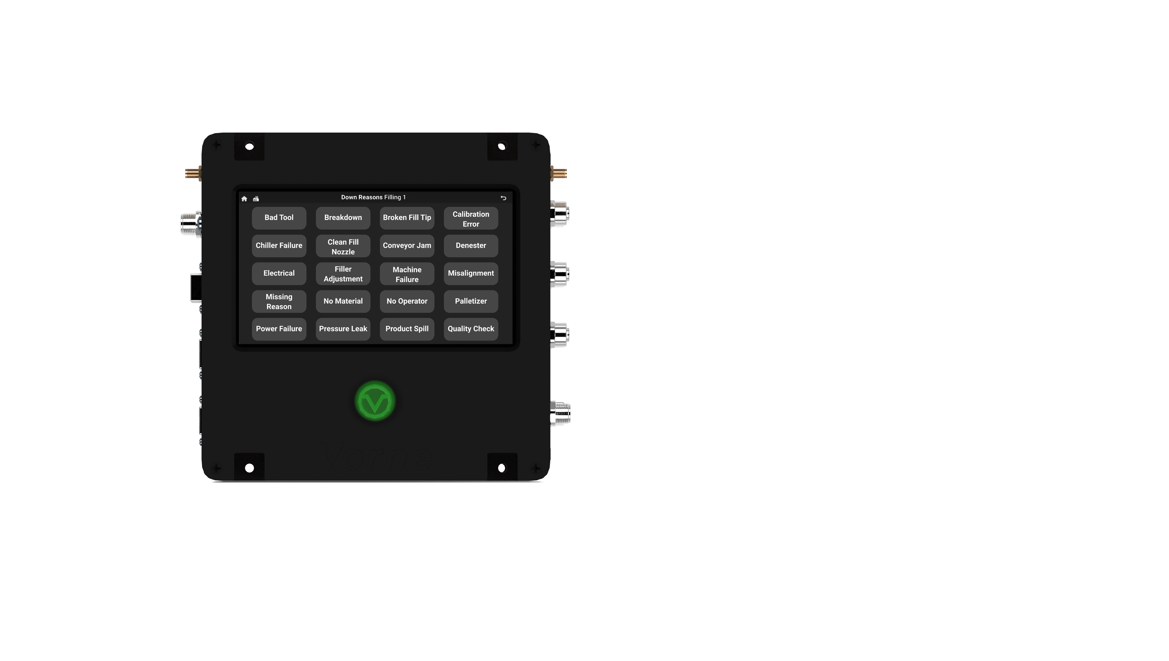
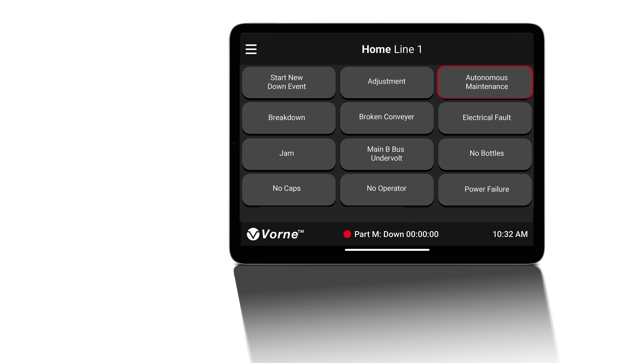
Performing Actions
Actions can be performed in
several ways.
Barcode scanner (connects to device via USB)
Touch interface on device (for certain models)
Touch interface on tablet or phone (XL Sidekick App)
Title Part 1 Section 1
www.vorne.com • 1.630.875.3600 • © 2026 Vorne
www.vorne.com • 1.630.875.3600 • © 2026 Vorne
Notes:
Related notes:
After the Scanning slide – add a slide on “the touch UI” – emphasize that it’s in both Touch and Sidekick

Slide 9

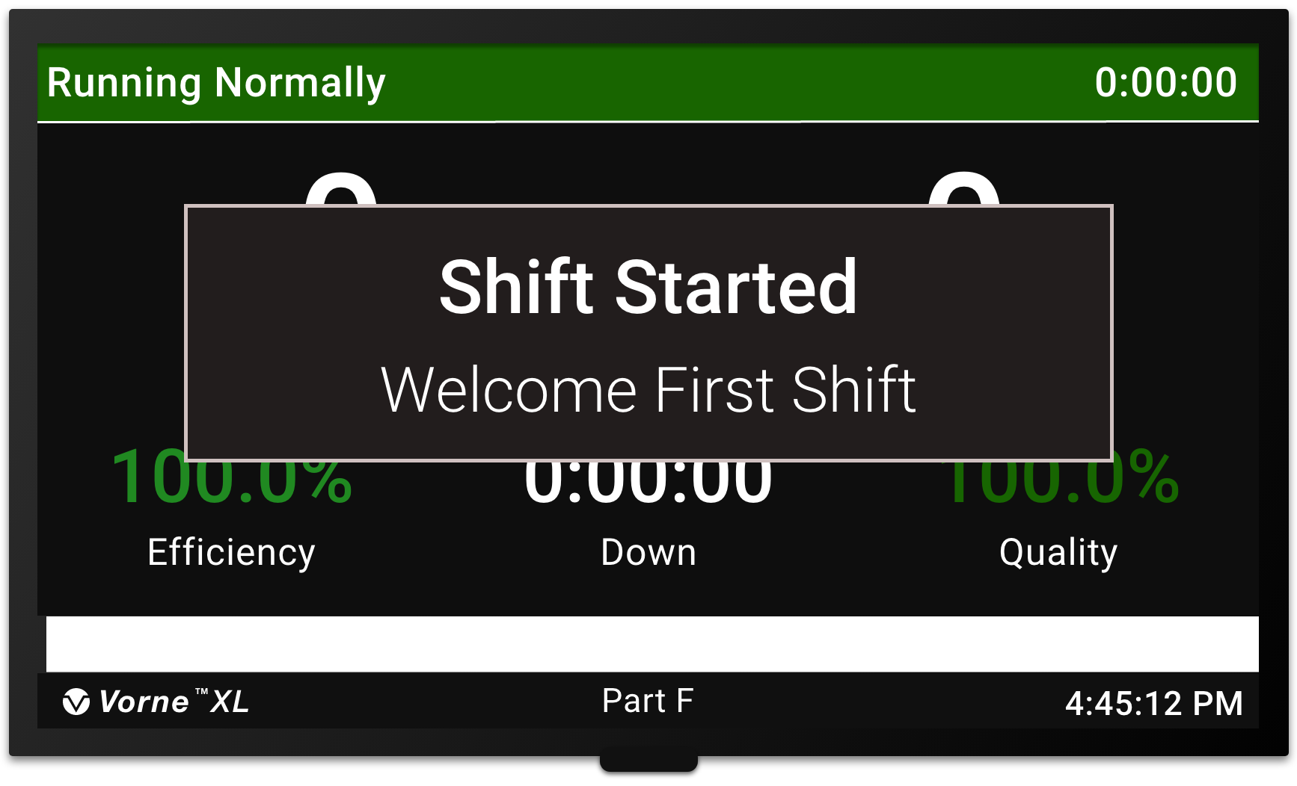
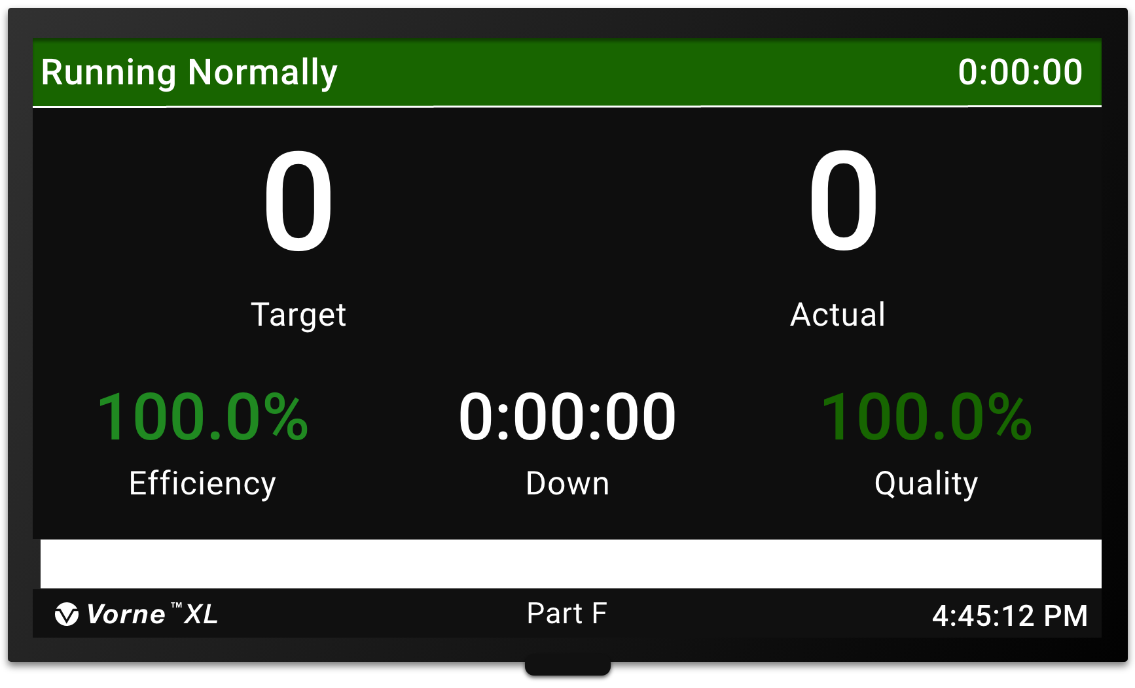
Start Shift
Our shift begins automatically.
Shift begins at scheduled start time (XL automatically begins the shift)
Scoreboard (shows Shift ID, then KPIs)
XL counts time outside of the shift as Not Scheduled (so it does not affect OEE)
Welcome !
!
KPI Screen
Select One
Title Part 1 Section 1
www.vorne.com • 1.630.875.3600 • © 2026 Vorne
www.vorne.com • 1.630.875.3600 • © 2026 Vorne

Slide 10
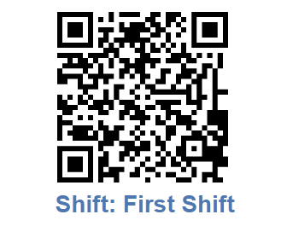
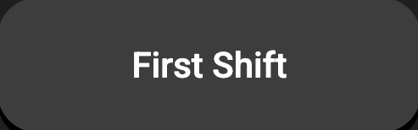
Start Shift
or
Our shift begins when we
perform an action
Operator begins shift (by scanning the Shift ID barcode or pressing the Shift ID button)
Scoreboard (shows Shift ID, then KPIs)
XL counts time outside of the shift as Not Scheduled (so it does not affect OEE)
Welcome !
!
KPI Screen
Select One
Title Part 1 Section 1
www.vorne.com • 1.630.875.3600 • © 2026 Vorne
www.vorne.com • 1.630.875.3600 • © 2026 Vorne

Slide 11
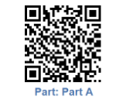
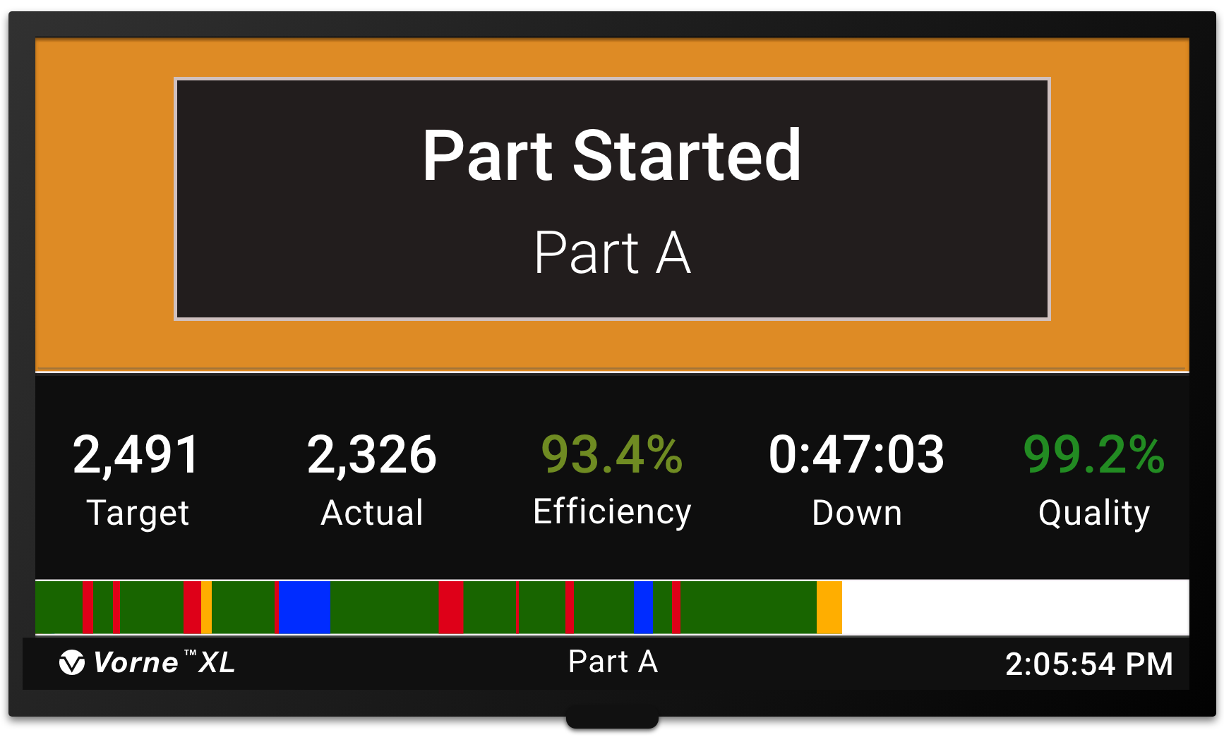
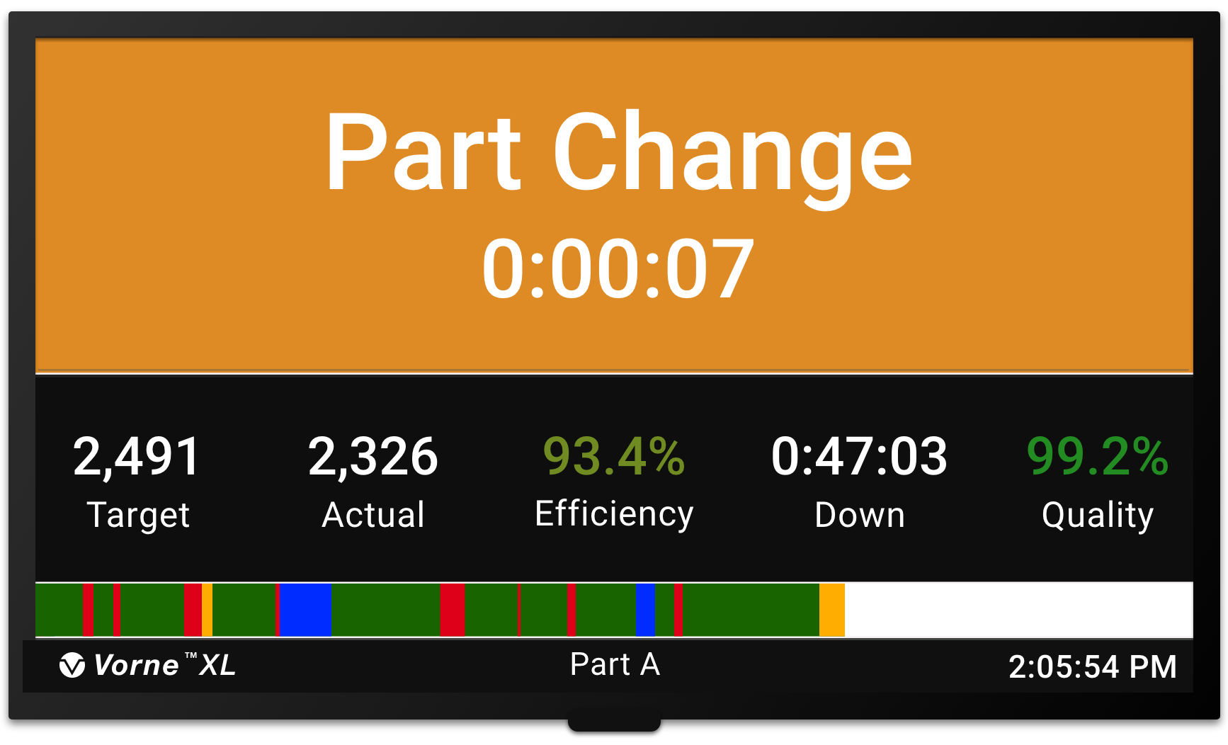
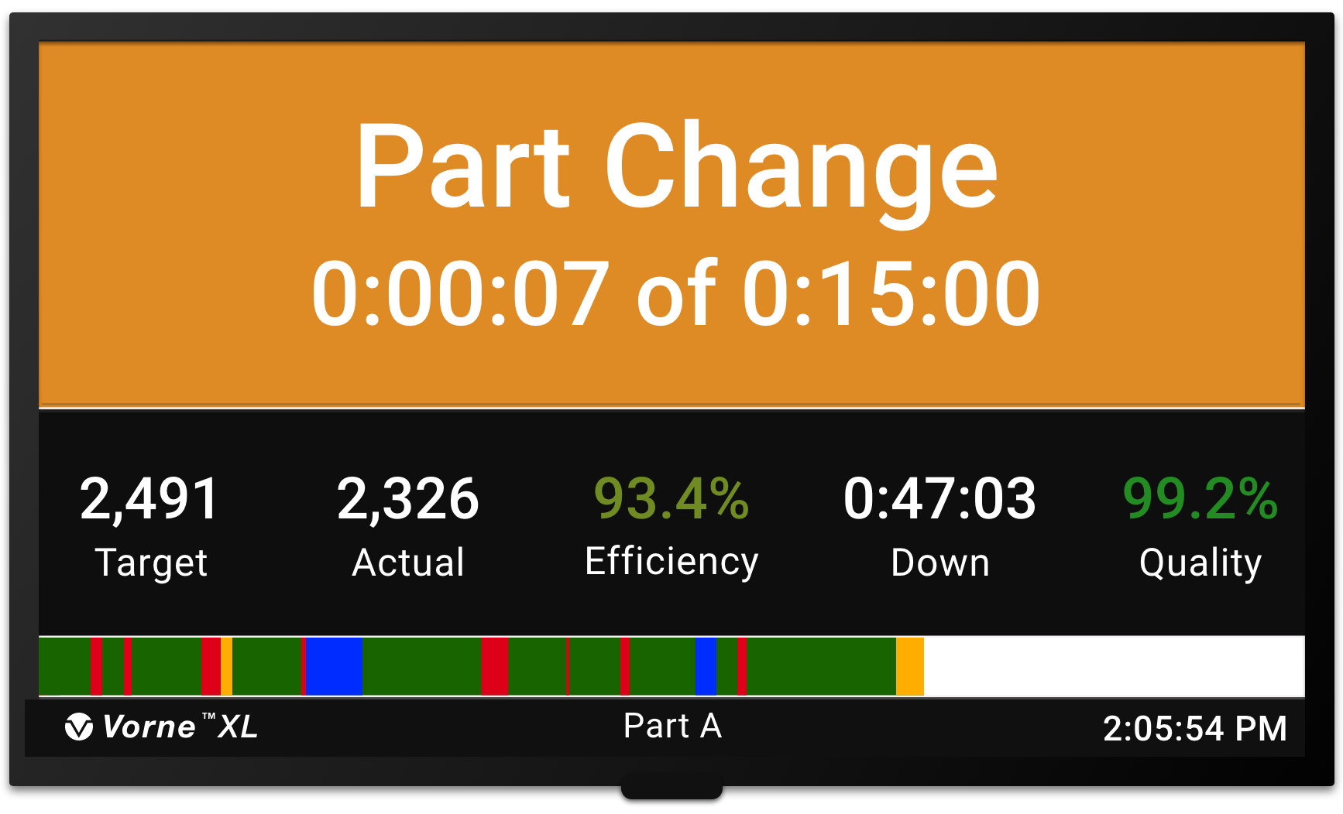
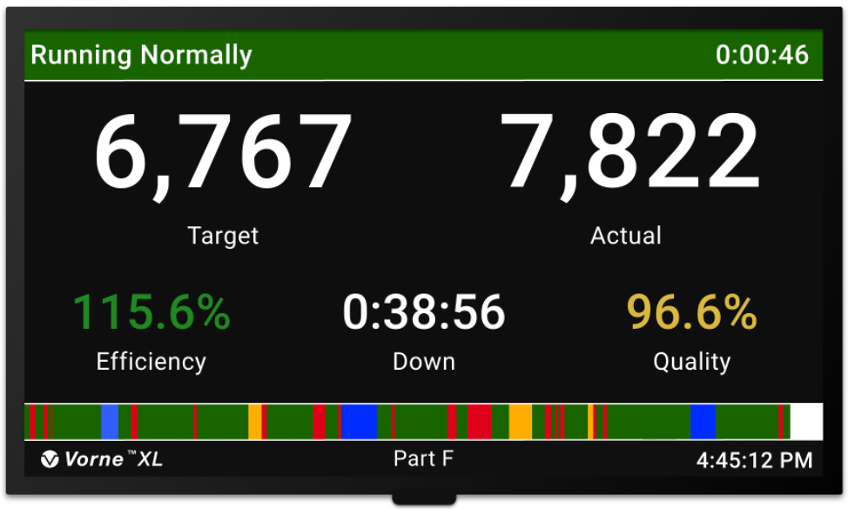
Start Part
or
Part A
For each part we run, and the part begins with a changeover.
Operator starts part (by scanning the specified Part ID barcode or pressing the specified Part ID button)
Scoreboard (shows Part ID for five seconds, then Changeover status)
End Changeover
  by target time,
  by starting production, or
  by operator
Scoreboard (shows KPIs)
Part ID
or
Changeover
End by target
End by operator
End by running
End Changeover
!
Select One
KPI Screen
Title Part 1 Section 1
www.vorne.com • 1.630.875.3600 • © 2026 Vorne
www.vorne.com • 1.630.875.3600 • © 2026 Vorne

Slide 12
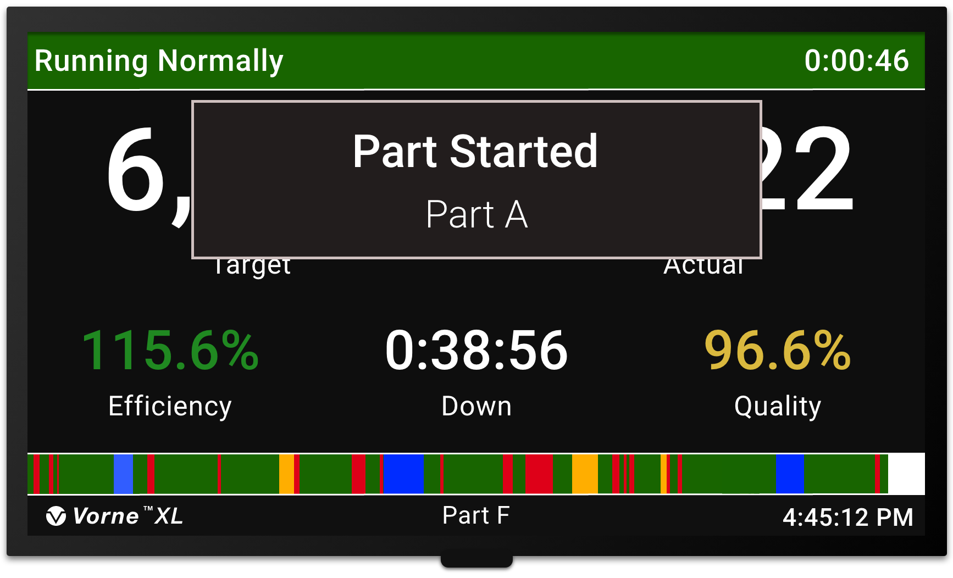
Start Part
For each part we run.
or
Part A
Scan Part (scan the appropriate Part ID barcode)
Scoreboard (shows Part ID for five seconds, then KPIs)
Part ID
!
Select One
KPI Screen
Title Part 1 Section 1
www.vorne.com • 1.630.875.3600 • © 2026 Vorne
www.vorne.com • 1.630.875.3600 • © 2026 Vorne

Slide 13
Run Scoreboard
Displays when we are Running
The scoreboard shows KPIs (key performance indicators)
Target shows your real-time production goal – aim to beat this number!
If Efficiency is 100% or greater, we are beating our Target and winning our shift
Efficiency changes color depending on how well we are running (red, yellow, green)
Title Part 1 Section 1
www.vorne.com • 1.630.875.3600 • © 2026 Vorne
www.vorne.com • 1.630.875.3600 • © 2026 Vorne
Notes:
Scoreboard slides:
start with the Running and Down slides

Slide 14
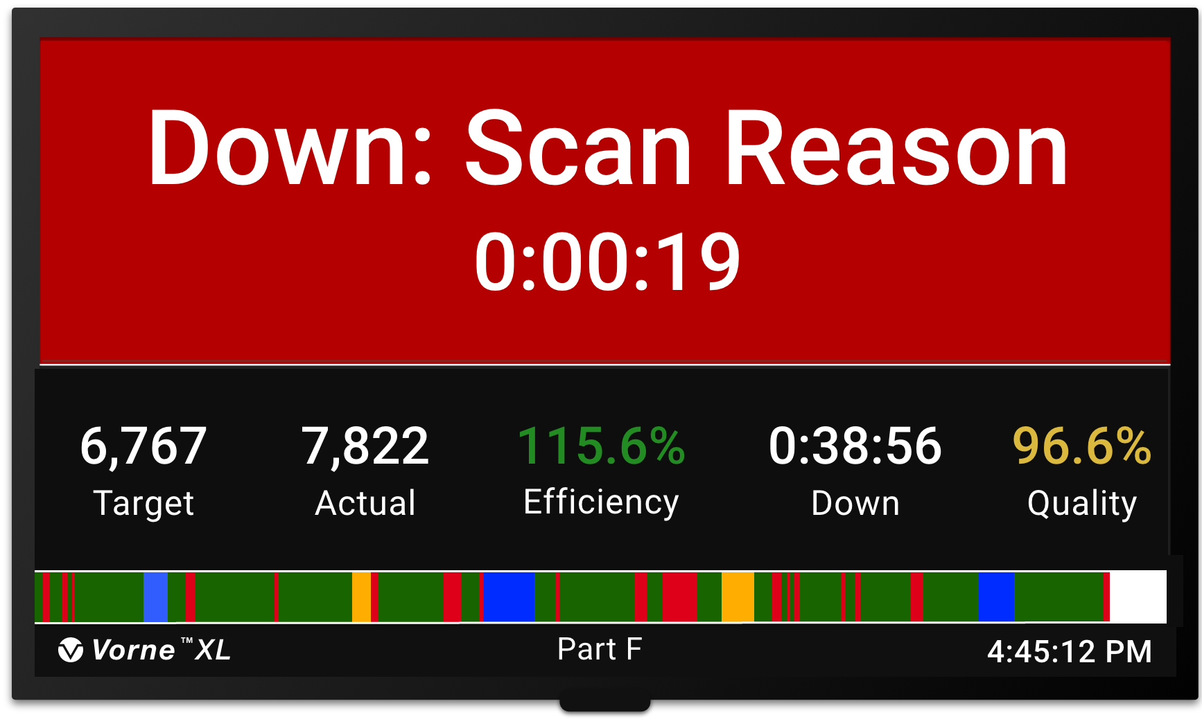
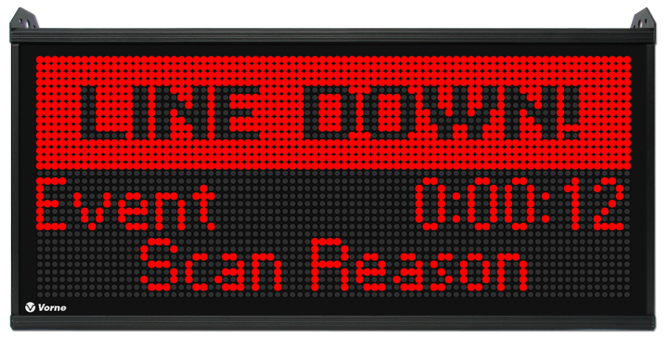
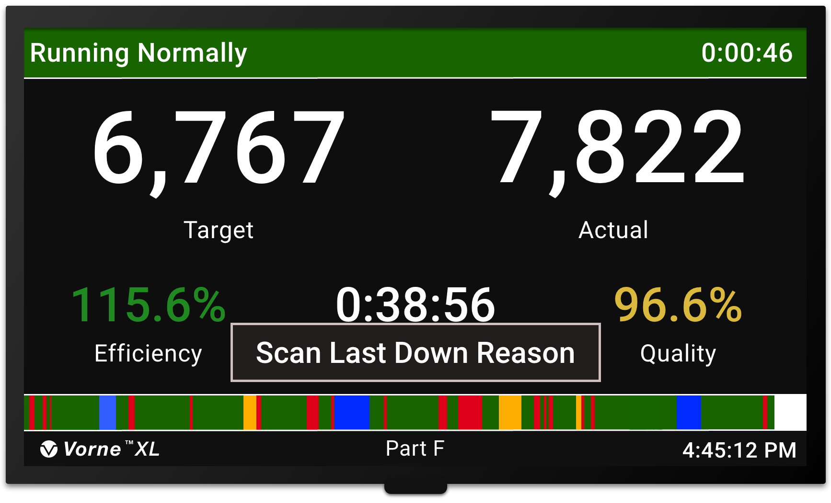
Down Scoreboard
Displays when we are Down
We don’t need to manually record down time – XL records down time automatically
We just input a reason when XL displays the Down Scoreboard
If we forget to input a reason, we can input after restarting the process
Title Part 1 Section 1
www.vorne.com • 1.630.875.3600 • © 2026 Vorne
www.vorne.com • 1.630.875.3600 • © 2026 Vorne

Slide 15
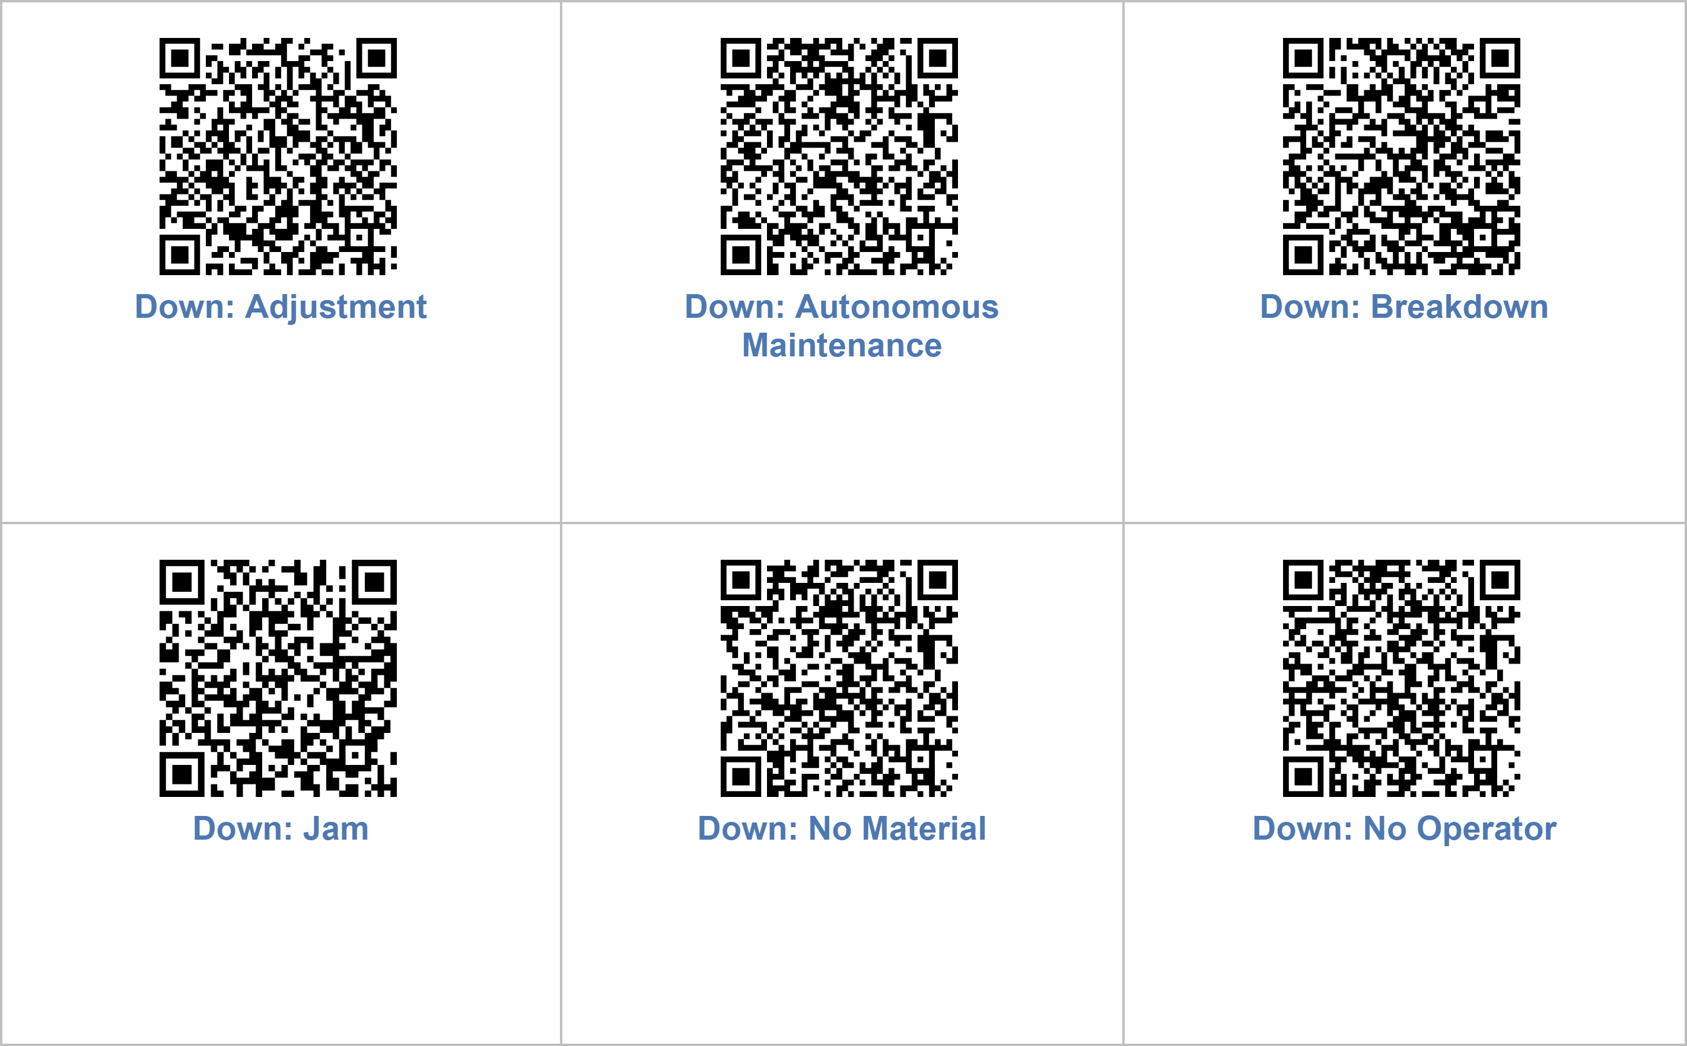
Reason Review
Let’s review our down reasons.
When should we input each of these reasons?
Are any of these reasons confusing?
Are we missing any reasons?
Are any reasons not needed?
Title Part 1 Section 1
www.vorne.com • 1.630.875.3600 • © 2026 Vorne
www.vorne.com • 1.630.875.3600 • © 2026 Vorne
Notes:
Good/keep this slide:
Down Reason Exercise – “let your managers know” if there’s something team should change/add etc.
– aligns to “culture of productivity”
ADD a “Detecting State” slide in Scoreboard section (and explain when this Scoreboard view shows up)

Slide 16
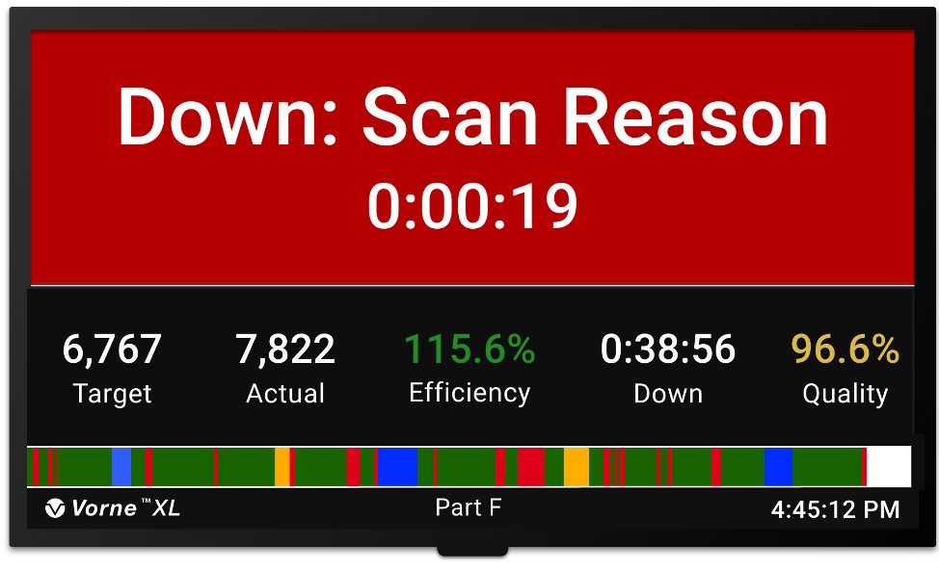
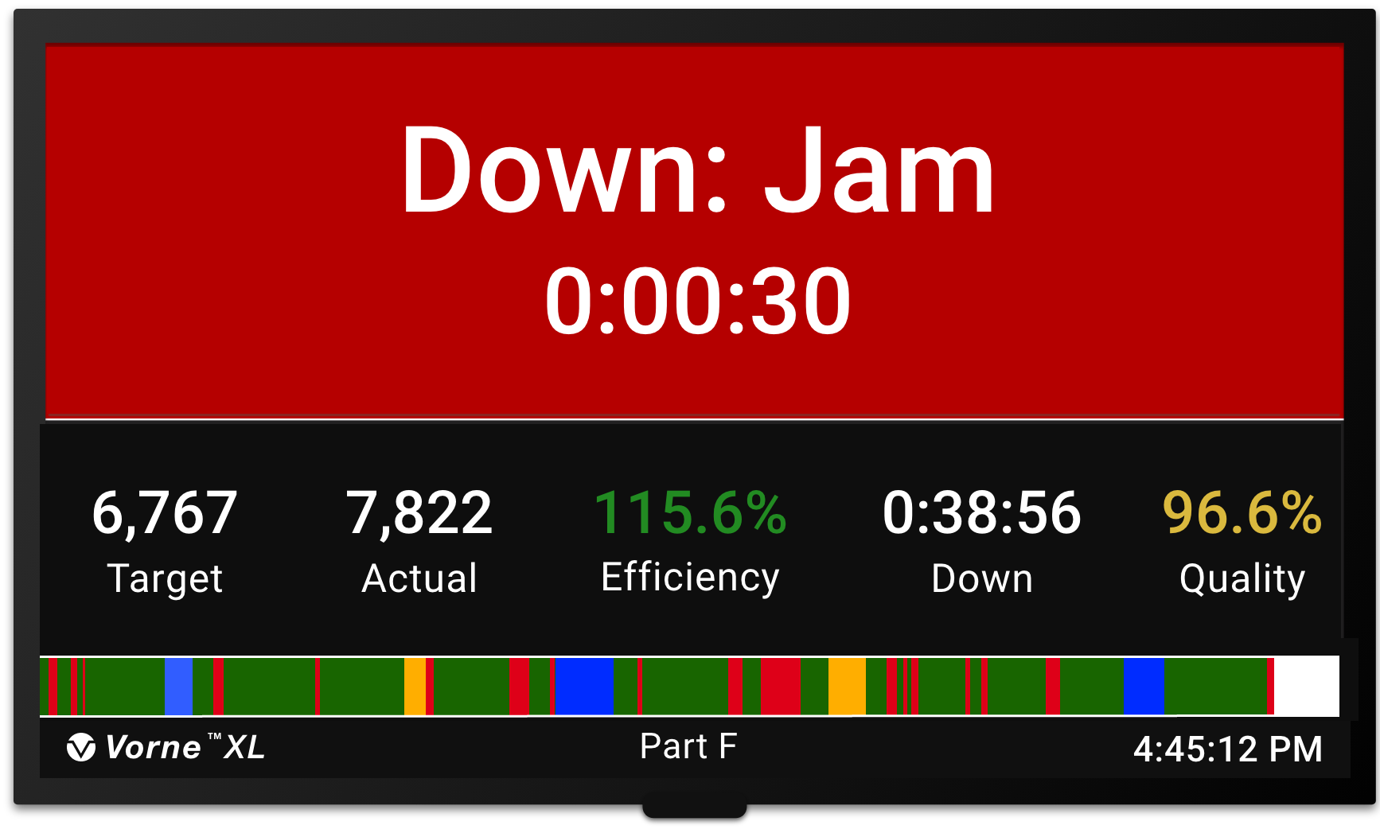
Input Down Reason
Follow these instructions for inputting down reasons.
Down Scoreboard
First focus on getting the process running
Input the appropriate reason as soon as you can
You can input the reason any time before the next down event
If you input the wrong reason, simply input the correct reason before the next down event (this will override the previous input)
If you forget to input a reason, XL displays Scan Reason at the bottom of the Run Screen
Input Reason
Reason Displayed
Run Scoreboard
Title Part 1 Section 1
www.vorne.com • 1.630.875.3600 • © 2026 Vorne
www.vorne.com • 1.630.875.3600 • © 2026 Vorne

Slide 17
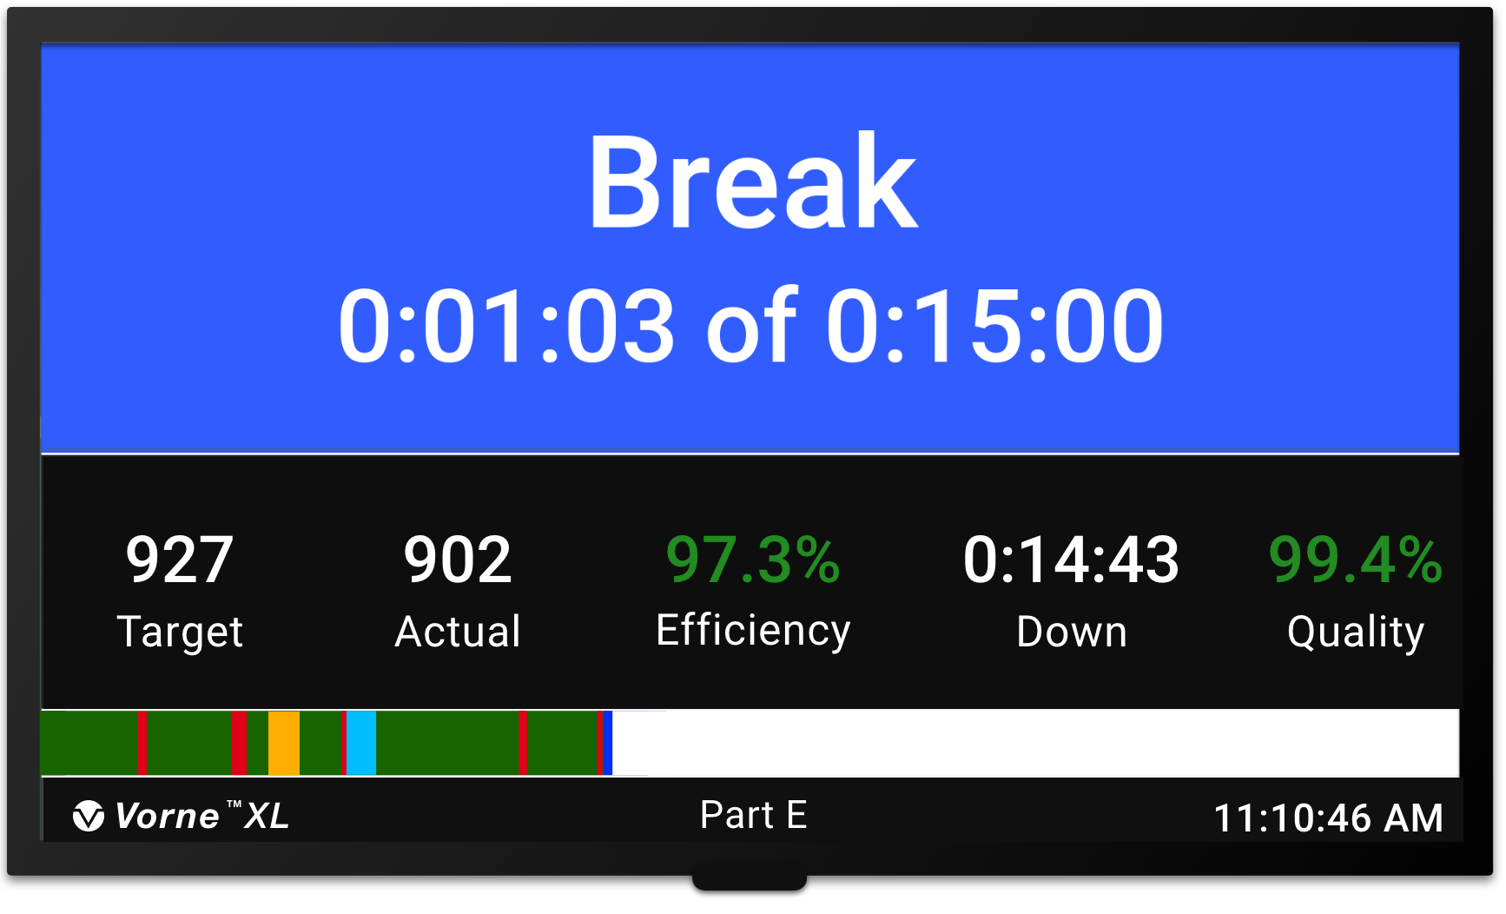
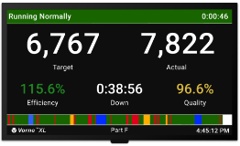
Start Break
Our break begins automatically.
Break Starts (XL automatically starts the break)
Scoreboard (shows remaining break time, then KPIs)
Remaining Break Time
Break Over
!
Select One
Title Part 1 Section 1
www.vorne.com • 1.630.875.3600 • © 2026 Vorne
www.vorne.com • 1.630.875.3600 • © 2026 Vorne

Slide 18
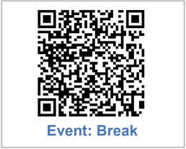
Start Break
or
Break
Our break begins when we
perform an action.
Operator begins break (by scanning the Break barcode or pressing the Break button)
Scoreboard (shows remaining break time, then KPIs)
Remaining Break Time
Break Over
!
Select One
Title Part 1 Section 1
www.vorne.com • 1.630.875.3600 • © 2026 Vorne
www.vorne.com • 1.630.875.3600 • © 2026 Vorne

Slide 19
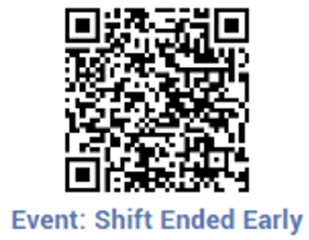
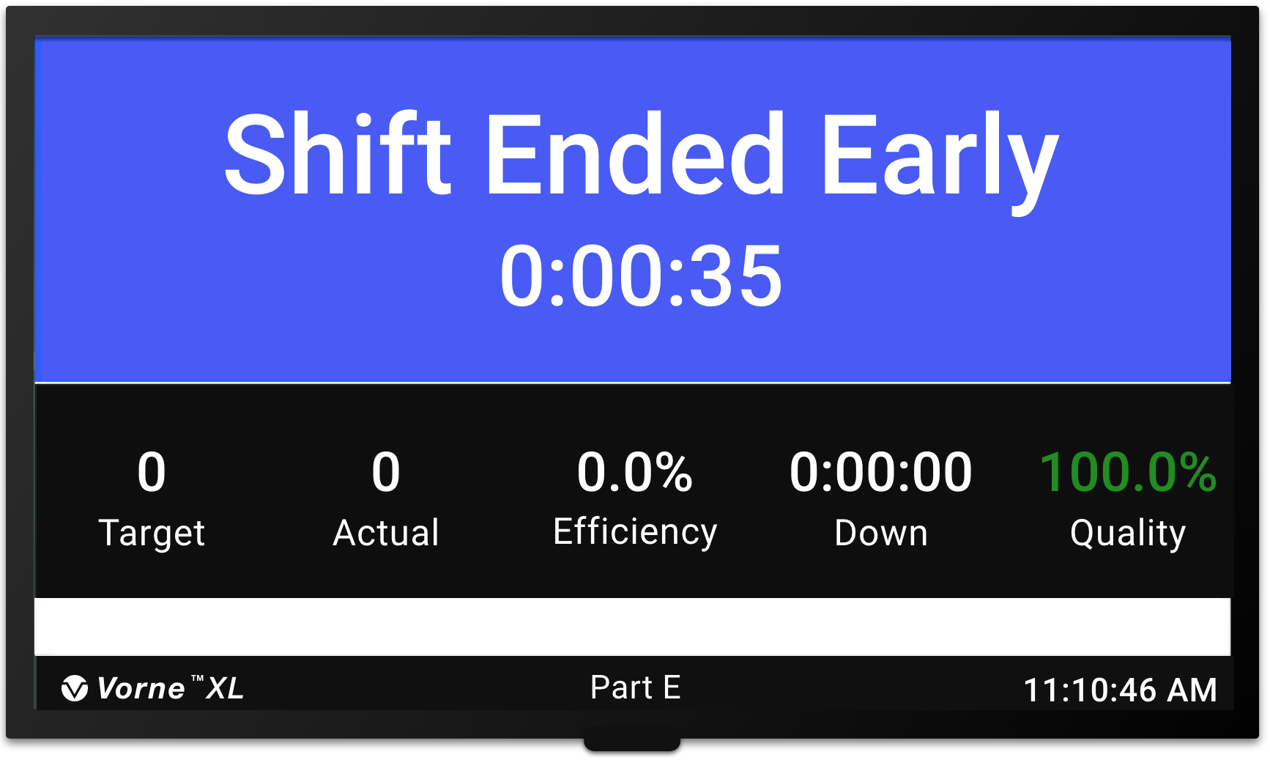
No Production
Input if there is no more work scheduled for a time-scheduled shift.
Input Shift Ended Early (scan barcode or press button so idle time is not counted against OEE)
Scoreboard (shows reason and accumulated time)
or
Shift Ended Early
No Production Timer
Title Part 1 Section 1
www.vorne.com • 1.630.875.3600 • © 2026 Vorne
www.vorne.com • 1.630.875.3600 • © 2026 Vorne

Slide 20
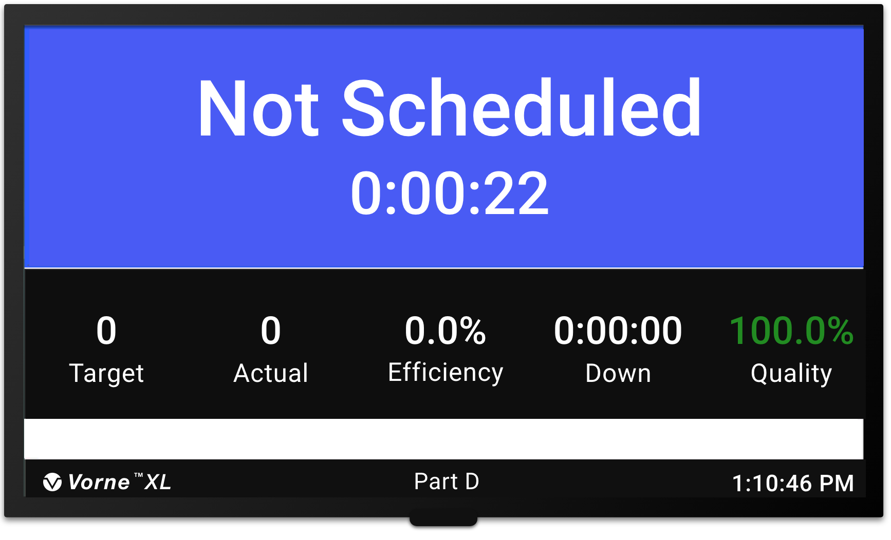
End Shift
Our shift ends automatically.
Shift Ends (XL automatically ends the shift)
Scoreboard (shows Not Scheduled time)
Not Scheduled Timer
!
Select One
Title Part 1 Section 1
www.vorne.com • 1.630.875.3600 • © 2026 Vorne
www.vorne.com • 1.630.875.3600 • © 2026 Vorne

Slide 21
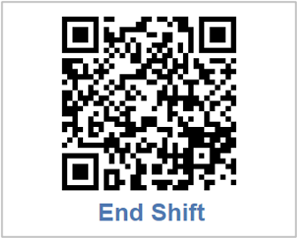
End Shift
Our shift ends when we
perform an action.
or
End Shift
Operator ends shift break (by scanning the End Shift barcode or pressing the End Shift button)
Scoreboard (shows Not Scheduled time)
Not Scheduled Timer
!
Select One
Title Part 1 Section 1
www.vorne.com • 1.630.875.3600 • © 2026 Vorne
www.vorne.com • 1.630.875.3600 • © 2026 Vorne

Slide 22
Frequently Asked Questions
Additional XL Insights for Your Team
What If I Don’t Scan
a Down Reason?
What If I Forget to End
My Shift?
Can We Change Scoreboard KPIs?
You can scan a down reason any time before the next down event
If you don’t scan anything the event will be assigned a reason of Missing Reason
Use the time schedule when possible to start and end shifts
Otherwise, it is very important to scan End Shift
If you forget, XL will capture the time as down time
Yes, your XL Champion can change the KPIs on the run screen
Title Part 1 Section x
www.vorne.com • 1.630.875.3600 • © 2025 Vorne
www.vorne.com • 1.630.875.3600 • © 2026 Vorne

Slide 23

Thank you for using Vorne XL
Email
Call
Visit
sales@vorne.com
+1.630.875.3600
www.vorne.com
www.vorne.com • 1.630.875.3600 • © 2026 Vorne Industries, Inc. • Itasca, IL

